Slide 1
Getting “LinkedIn”
Using LinkedIn to its fullest potential

Slide 2
Why LinkedIn®?
Employees
Business owners
Notes:
Tonight we will:
Briefly revisit the basics
Create or update your profile
Invite people to connect
Discuss other creative uses for LinkedIn
Plan how to keep your profile current
Review more advanced concepts for business owners
Identify and contact potential partners
Position yourself as an expert
Use recommendations to build credibility
Develop contact list of publications and use LinkedIn for PR
Participate effectively in groups
Create valuable Linked In events

Slide 3
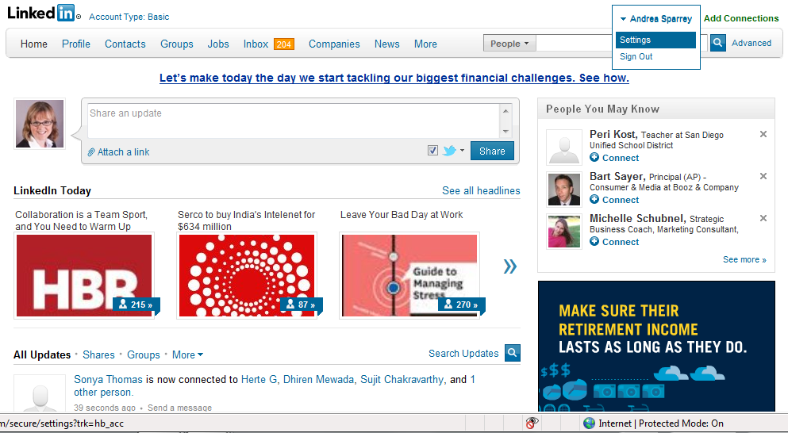


Before we get started, update settings so contacts do not get changes(1/3)
Select “settings”

Slide 4
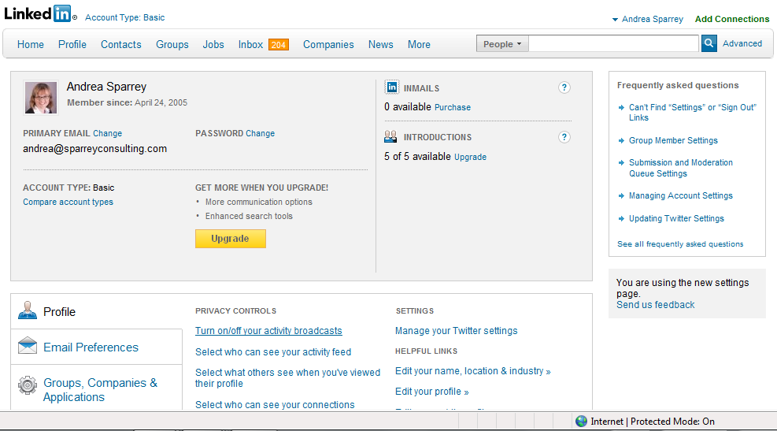
Before we get started, update settings so contacts do not get changes(2/3)
Click turn on/off activity broadcasts

Slide 5
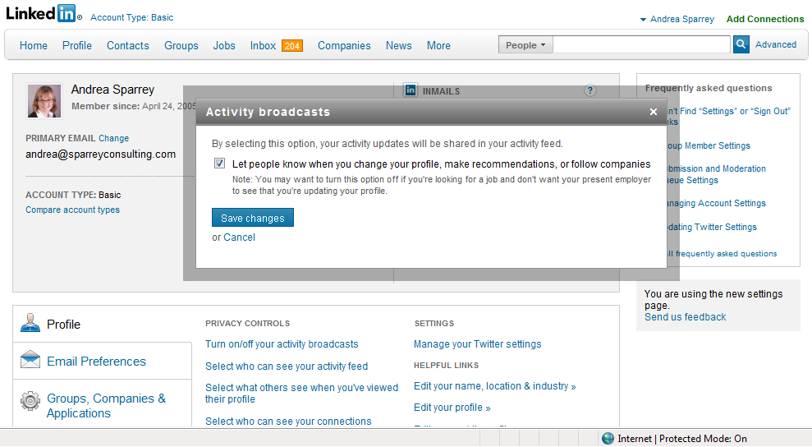
Before we get started, update settings so contacts do not get changes(3/3)
Unclick that button and updates don’t go to contacts

Slide 6
How to use LinkedIn® to build your personal brand
Post jobs
Conduct research
Networking
(Not netbegging)
Establish expertise
Build
credibility
Make yourself known to employers
Generate
publicity
Learn more about prospective employees

Slide 7
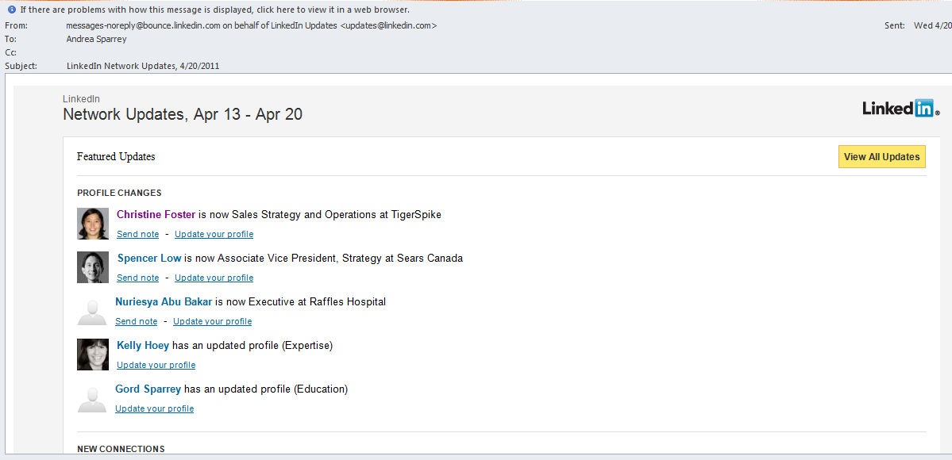
Use LinkedIn® to actively network: be proactive and stay in touch

Slide 8
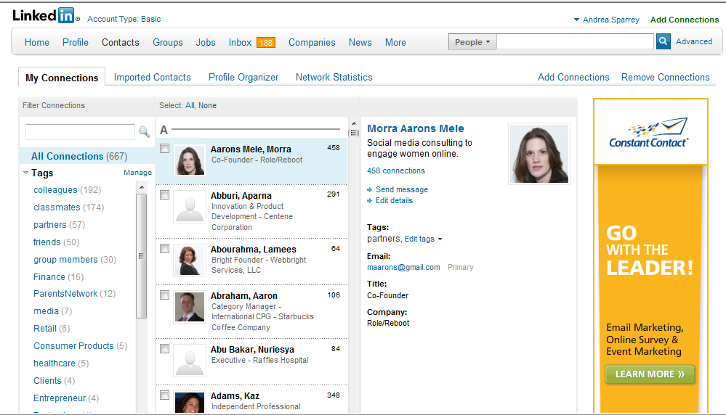
Create categories on profiles using tags and manage tags
2
1
1: put tags on individual profiles
2: manage tags

Slide 9
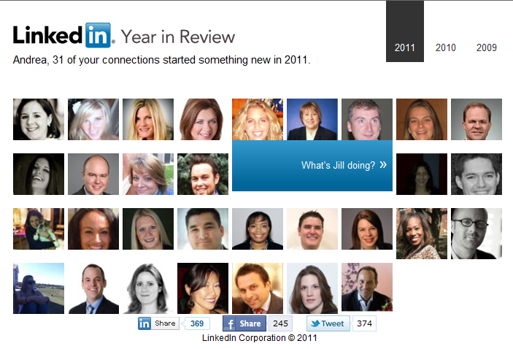
Reach out using the Year in Review feature as well
Year in review (http://yir.linkedinlabs.com/) offers a great chance to do that.

Slide 10
Start with a powerful headline that helps people to find you
Old headline | New headline
Senior Manager, Deloitte Consulting | Senior Manager, Deloitte Consulting, Financial Services Practice
Social media consulting to engage women online | Principal, Women Online, Social Media Consulting Firm engaging women for leading corporations and non-profits
President at Hera Hub | President at Hera Hub, collaborative office workspaces for women
Career Coach | Chief Talent Advisor, Sparrey Consulting, committed to helping exceptional young people achieve their goals
Employee
Owner

Slide 11
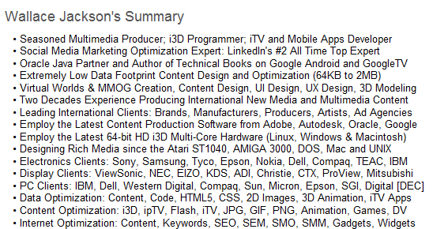
Provide a summary that highlights your skills, consider who is looking for you
Listing specific skills (SEO optimized)

Slide 12
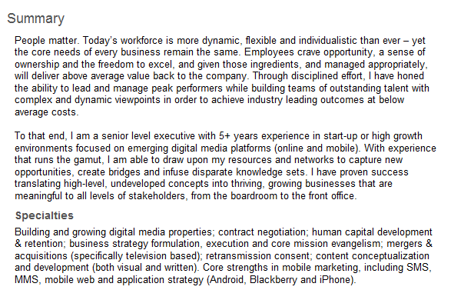
Provide a summary that highlights your skills, consider who is looking for you
Attempting to connect with reader
- Brian G. Bauer

Slide 13
Review basics in your profile to put your best foot forward
Appearance
Does it look organized?
Is it easy to follow?
Work experiences
How many experiences should you include?
Have you made yourself easy to find?
What keywords, industry, company names would people be searching for?
What schools would you
Key details
Have you customized your website(s)?
Do you have companies / schools listed?
Have you included enough detail?

Slide 14
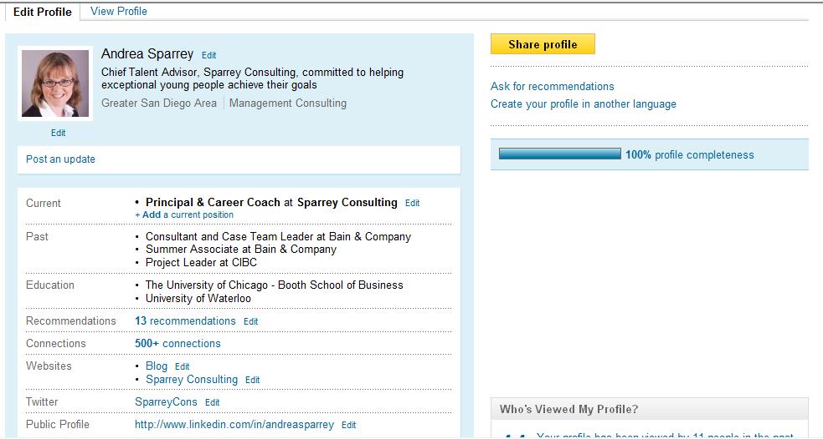
Customize your website link

Slide 15
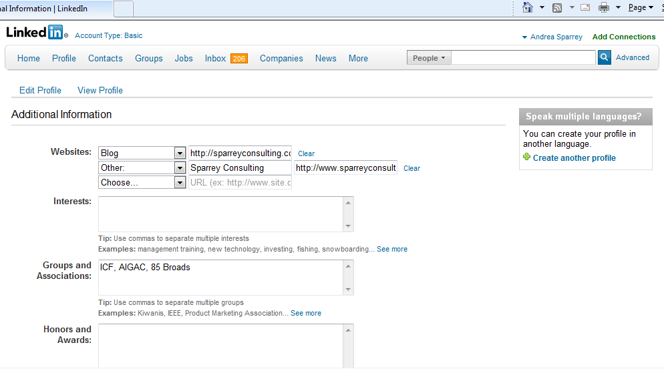
Customize your website link

Slide 16
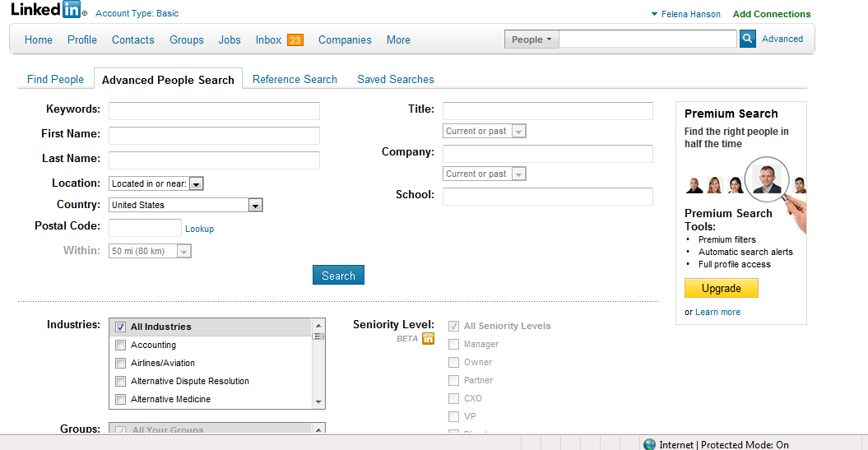
Use advanced search to find people that will be valuable to your network
Who might you want to find?
Suppliers
New Customers
Prospective employees
Referral Partners
Who Knows Who

Slide 17
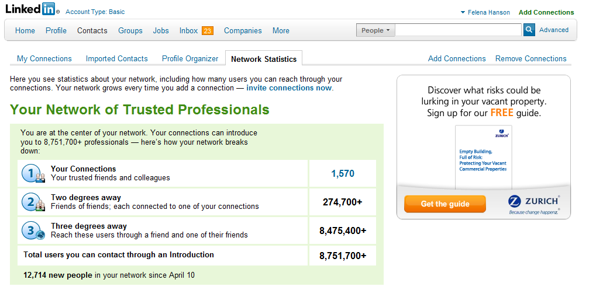
Study Your Network
v
v
v

Slide 18
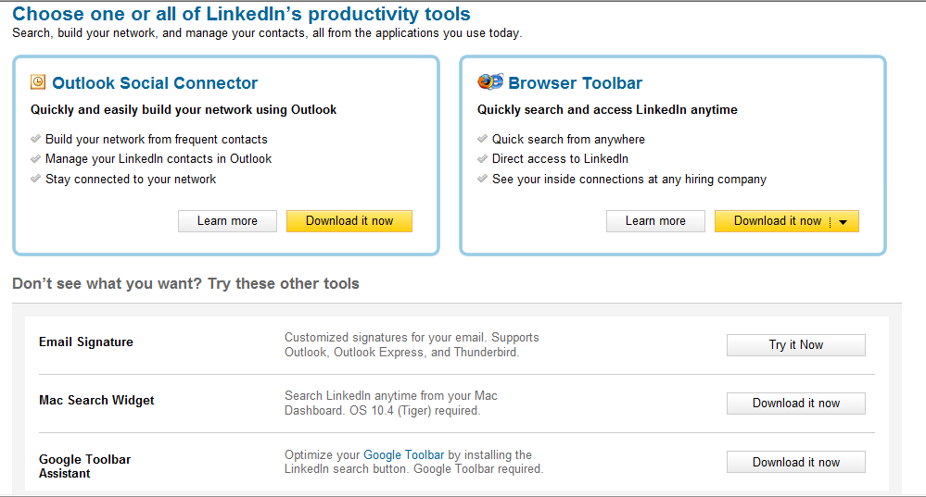
Use productivity tools to make it easier to maintain connections

Slide 19
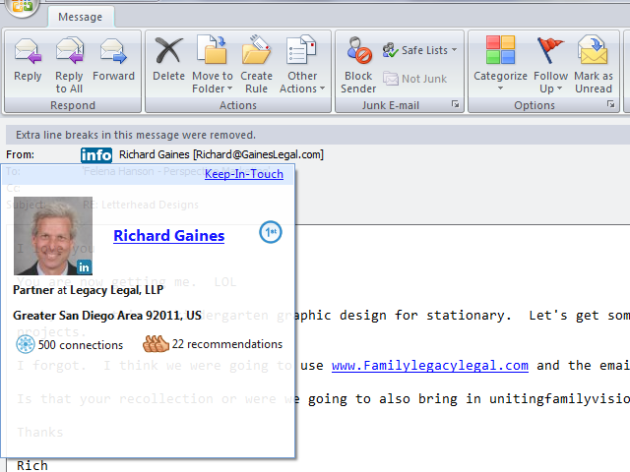
Outlook Toolbar
  Screens anyone you receive email from (also CC)
  Instant invite with templates
  Grab - puts contact into “Collected”
Recently bogging down Outlook a bit

Slide 20
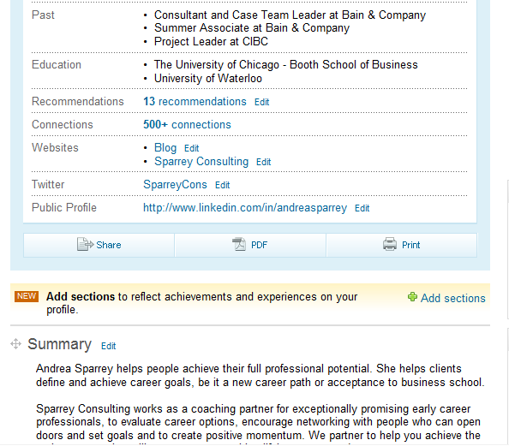
Details such as languages can stand out in a search(page 1 of 3)
Note: you can highlight awards, patents, publications, etc.
After selecting “edit profile”, click on “add sections”

Slide 21
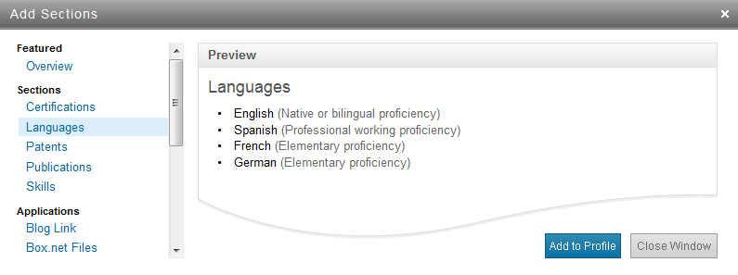
Include languages as a way to differentiate yourself (page 2 of 3)
In dialog box, select “languages” and then click on “add to profile”

Slide 22
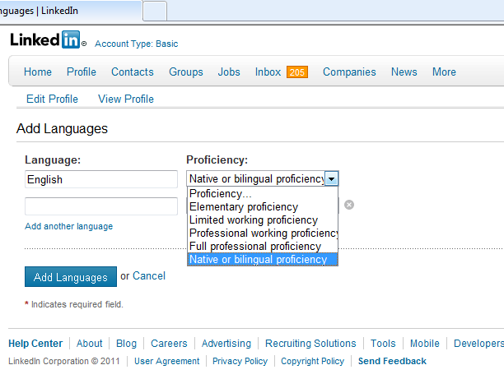
Include languages as a way to differentiate yourself (page 3 of 3)
Then, select your proficiency for each.

Slide 23
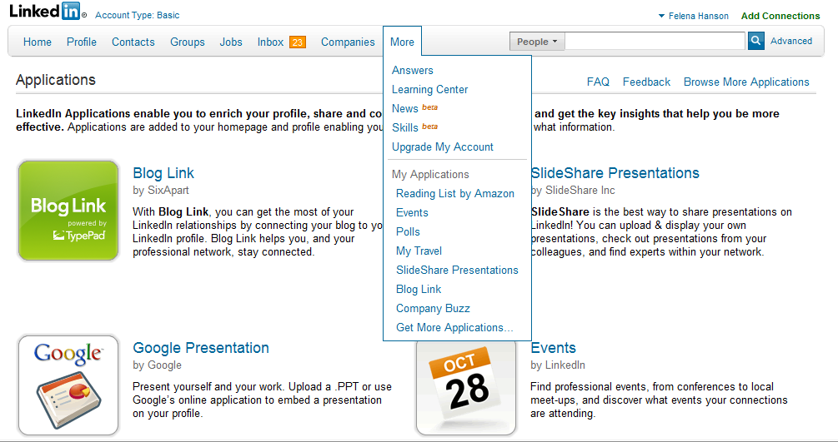
Applications can be a great way to reconnect with your network
TWITTER FEED – THE FACEBOOK LOOP

Slide 24
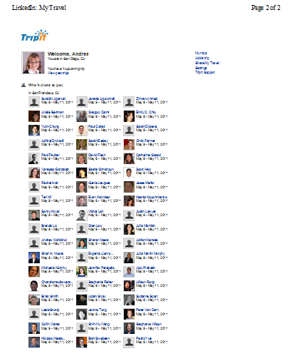
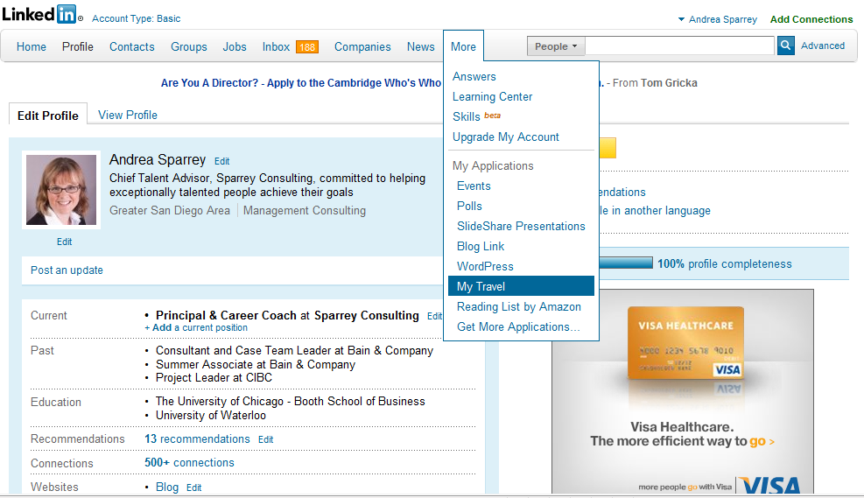
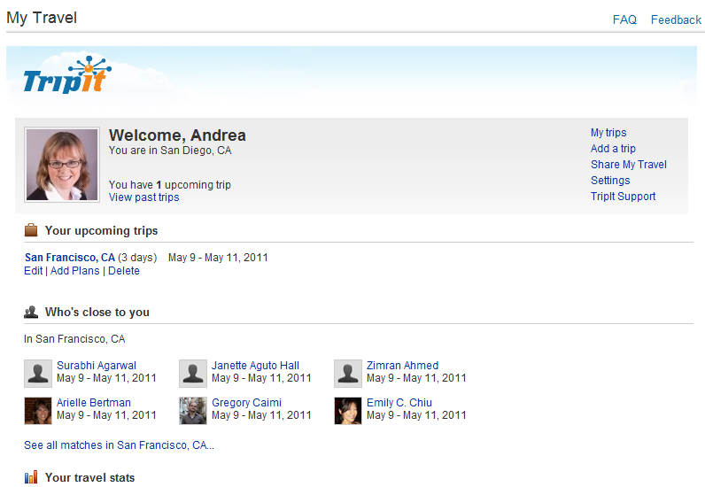
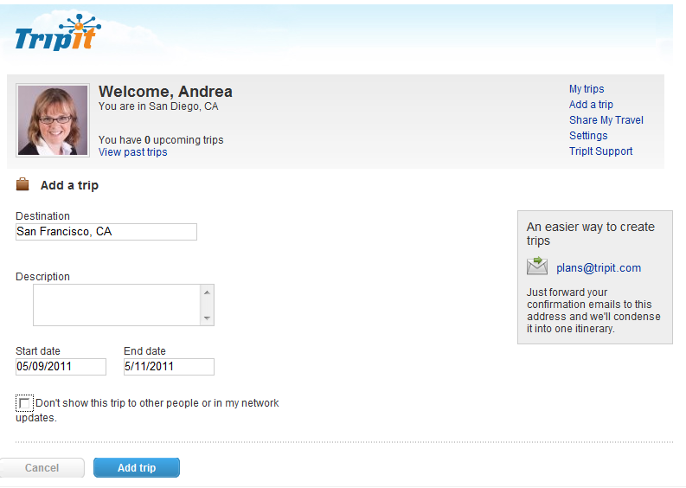
TripIt example

Slide 25
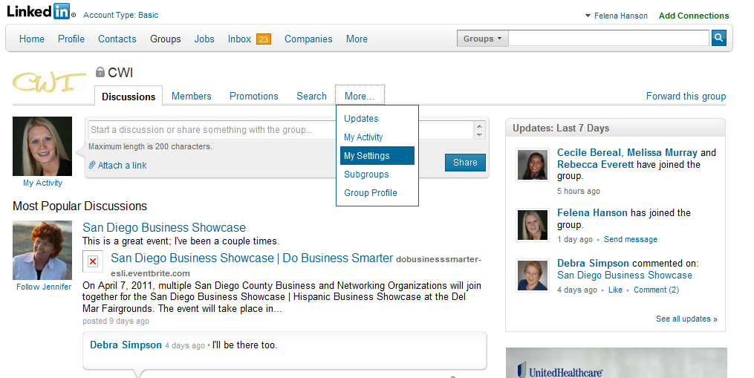
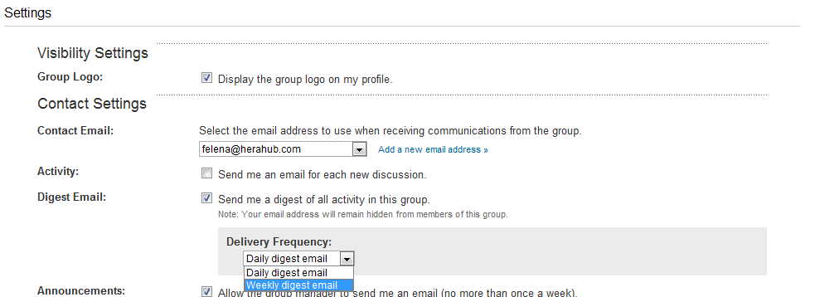
You can use groups efficiently, avoid incessant emails!
Public vs. Private
Join up to 50 groups
Find your customers in groups
Open gateway: connect & message group members
Search out expertise
Consider starting a group

Slide 26
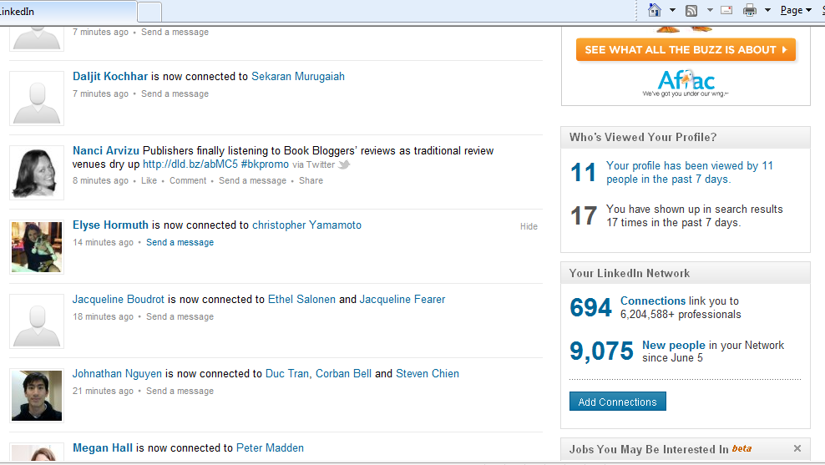
Use profile stats to check on who’s checking you out!

Slide 27
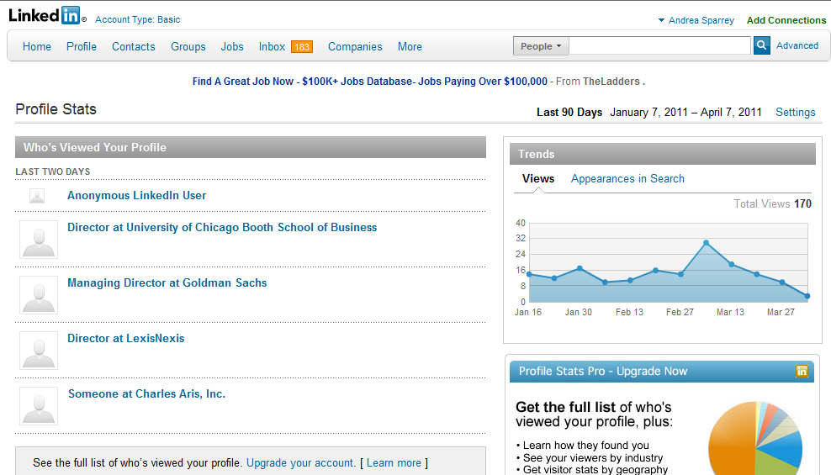
Use profile stats to check on who’s checking you out!

Slide 28
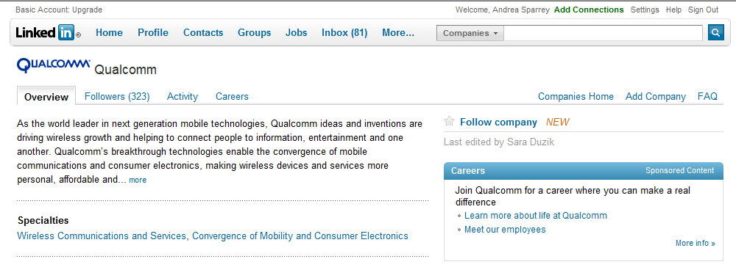
Conduct research about prospects and competitors using “follow company”
Use the follow company feature on LinkedIn to find out the following helpful information:
  Common career paths before and after the company
  Where employees are most connected
  Departments & levels for new hires
  Former employees and where they have departed to
  Recent promotions and changes

Slide 29

Position yourself as an expert
Include URL links in your summary or descriptions to sample work
  Thanks to Margot from The Word Factory for the tip
Ask questions to build credibility
  Rate answers to thank respondents
  If one stood out, select that as the “best” answer
Include answers application on your main profile page
  Identify categories where you may be an expert
  Review questions (put 30 minutes on your calendar on a weekly basis)
  Research person asking question to offer a personal response based on their LinkedIn profile
  Provide valuable tips in your response, including website links or introductions to experts
  Request “best answer” rating if appropriate

Slide 30
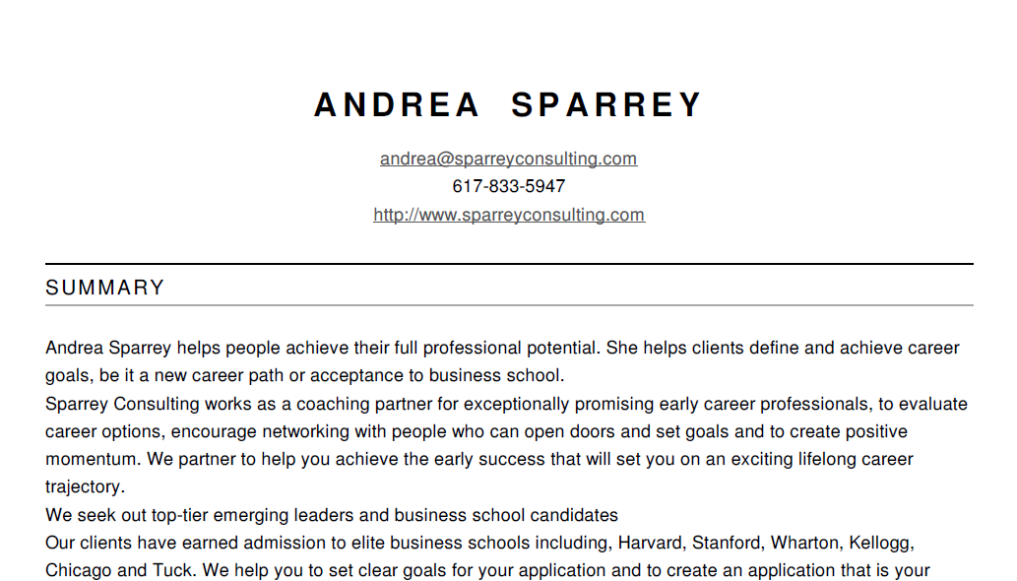
Create your own resume real-time from LinkedIn®
Use the content on your profile to create your resume
www.resume.linkedinlabs.com

Slide 31
Consider activities that are your priorities & get them done!
Activity | Frequency | Time required
Review contact update email | Weekly | 10 minutes
Reach out to someone just to say hi! | Weekly | 5 minutes
Update status | Weekly (Ent) Monthly (empl) | 5 minutes
Ask a question (or write an answer) | Weekly (Ent) Monthly (empl) | 10 minutes
Review profile – ask someone for feedback | Monthly | 5 minutes
Follow new companies | Monthly | 10 minutes
Recommend people | Monthly | 30 minutes
Search for people who meet a specific need | As applicable | 10 minutes
TripIt: Use travel plans as conversation starter | As applicable | 10 minutes
Include new books on reading list | As applicable | 5 minutes

Slide 32
Questions
Contact
Felena Hanson – felena@herahub.com
Andrea Sparrey – Andrea@sparreyconsulting.com

Slide 33
Suggested Default Settings
Go to upper right “Settings”
Working on the Left Column
Make the following changes until you know better and understand the impact of the settings completely.
Upload photo, visible to “everyone”
Public Profile displays “full” profile information. Customize your URL so that you can use it on your email signature such as http://www.linkedin.com/in/FelenaHanson
Member Feed visible to everyone
Contact Settings: “I’ll accept introductions and InMail”
Opportunity Preferences: I suggest checking boxes “consulting”, “ventures”, “expertise”, and “re-connect” at a minimum, and others at personal preference.
Invitation Filtering: “All Invitations”
Group Invitations: “Open to Receive”
Complements of Marco Thompson

Slide 34
Suggested Default Settings
Go to upper right “Settings”
Working on the Right Column
Name & Location: Display Name = Full First & Last Name
Email Addresses: List ALL email addresses, that any business contact might try to contact you through.
Connections Browse: Hide or not Hide
Profile Views: “Don’t Show Users that I have viewed their Profile”
Complements of Marco Thompson

Slide 35
Build credibility through recommendations
Should you have recommendations?
(Personal or business)?
Who should you ask?
How should you ask them?
What is your company’s policy?
Notes:
Giving recommendations to others can be a powerful tool
Be thoughtful in what you promote / say about others, provide specific examples where you can
Talk specifically about what you know and be careful not to address what you don’t!
Read other recommendations to see what ones impress you!
Don’t be shy about asking for recommendations
In a group setting, if you’re doing feedback surveys, you could suggest that they follow-up with a LinkedIn recommendation
If someone is writing a recommendation and asks about characteristics you want highlighted, be prepared
Save your recommendations in a standalone PDF file
Look up Wally Feigenson’s blog for more information

Slide 36
Why would someone get a LinkedIn® premium profile?
Profile contacts: save profiles that you’ve found and take notes re: prospective contacts
Profile views: see a complete list of who’s viewed your profile, could be valuable to estimate probability of new business
InMail messages: reach out to anyone on LinkedIn® with messages, consider if this is relevant for you
Search results: increase the number of people returned in each search
Profile detail: see expanded profiles for everyone on LinkedIn®
Open your profile: allows others to reach out and connect directly with you

